Slide 1
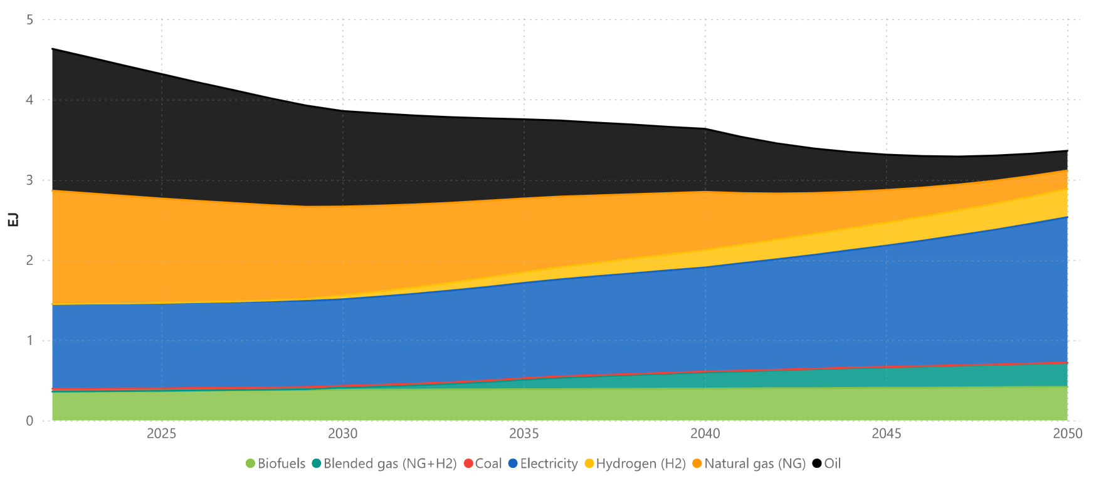
2022

Slide 3
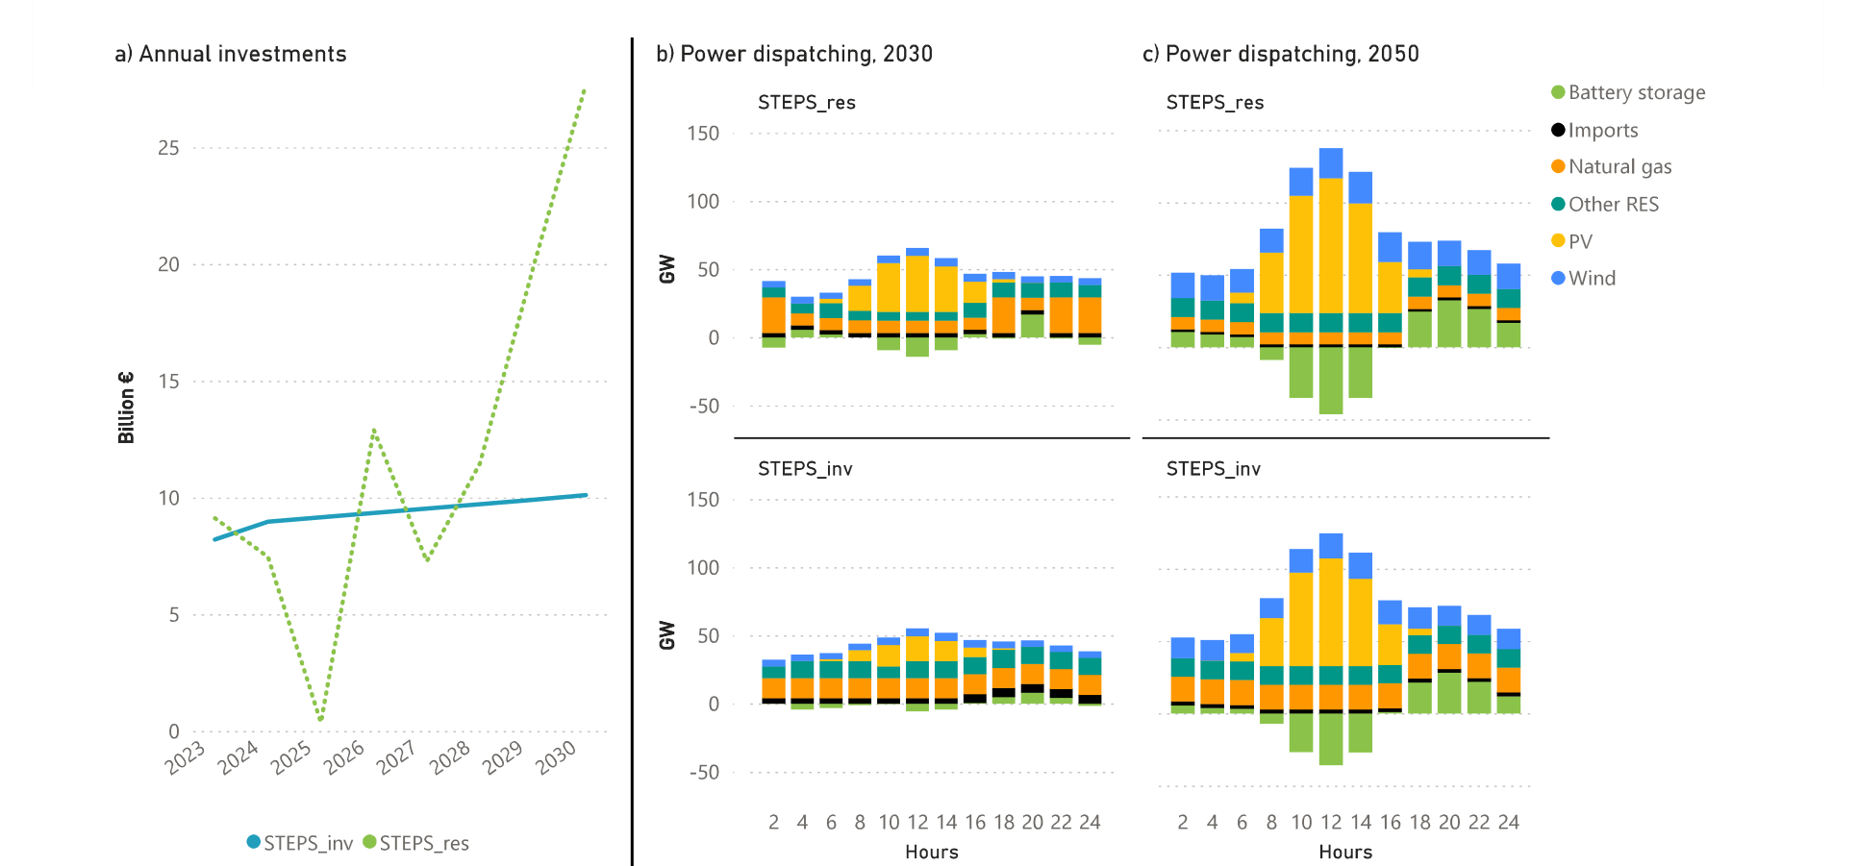

Slide 4
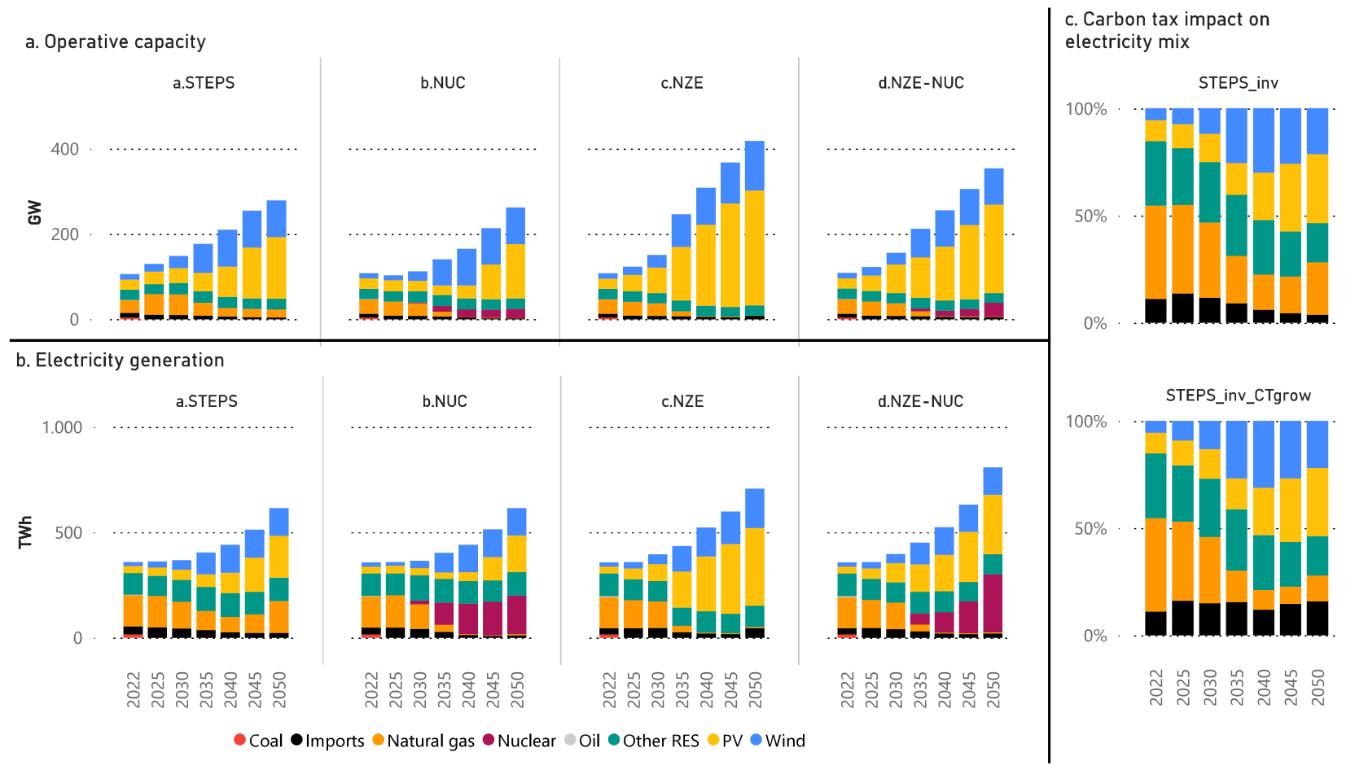
STEPS_inv (100€/kgCO2)
Natural gas: 24%
Imports: 4%
STEPS_inv (500€/kgCO2)
Natural gas: 12%
Imports: 16%

Slide 5
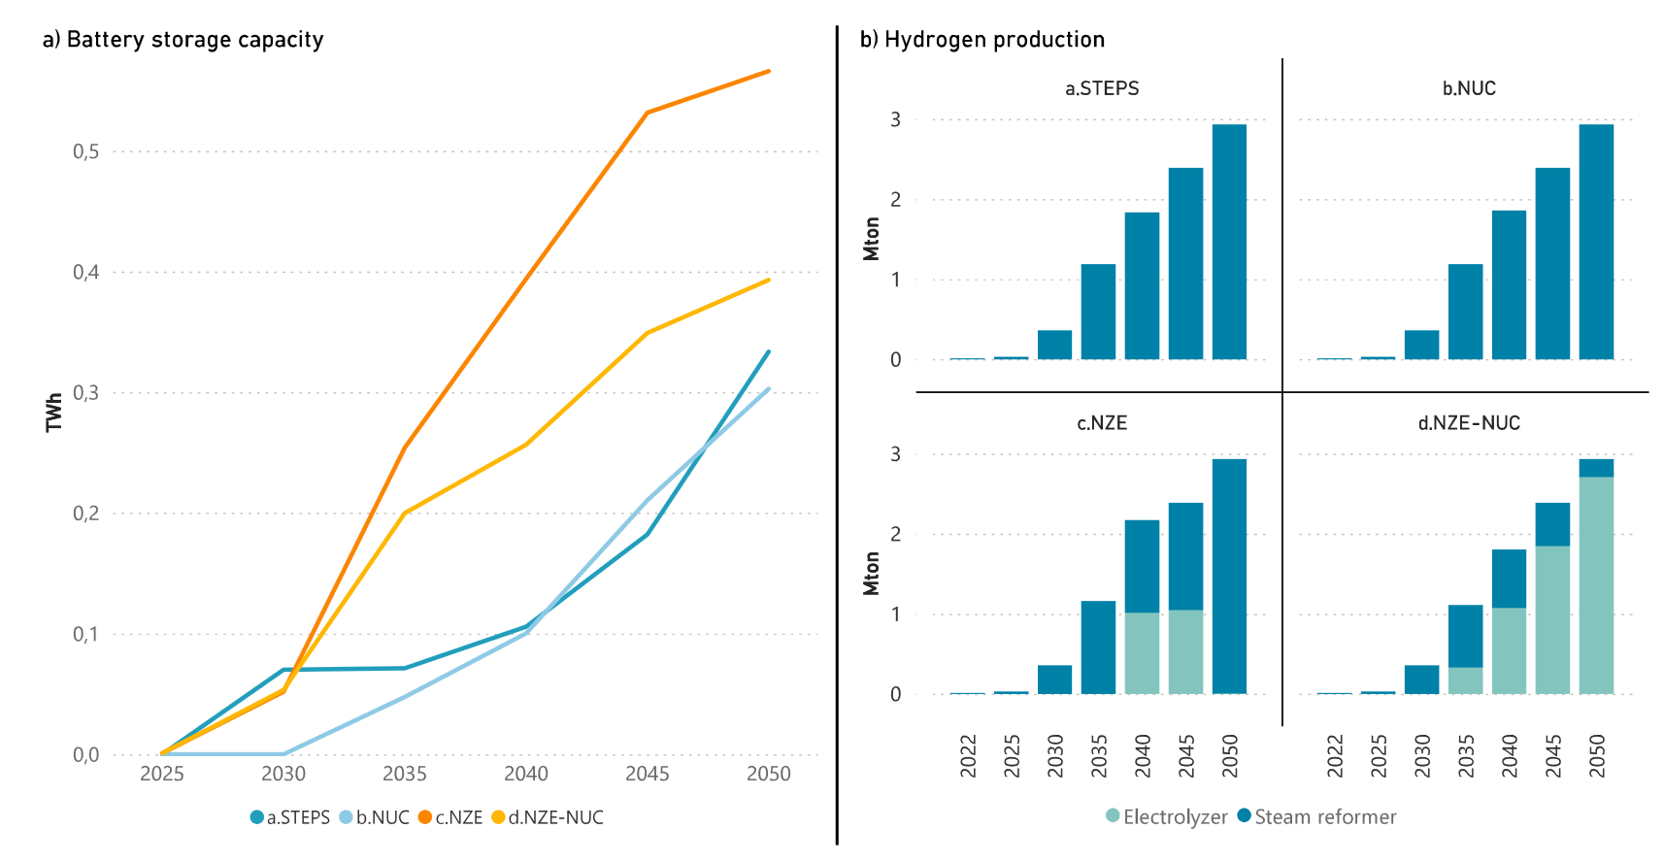

Slide 6
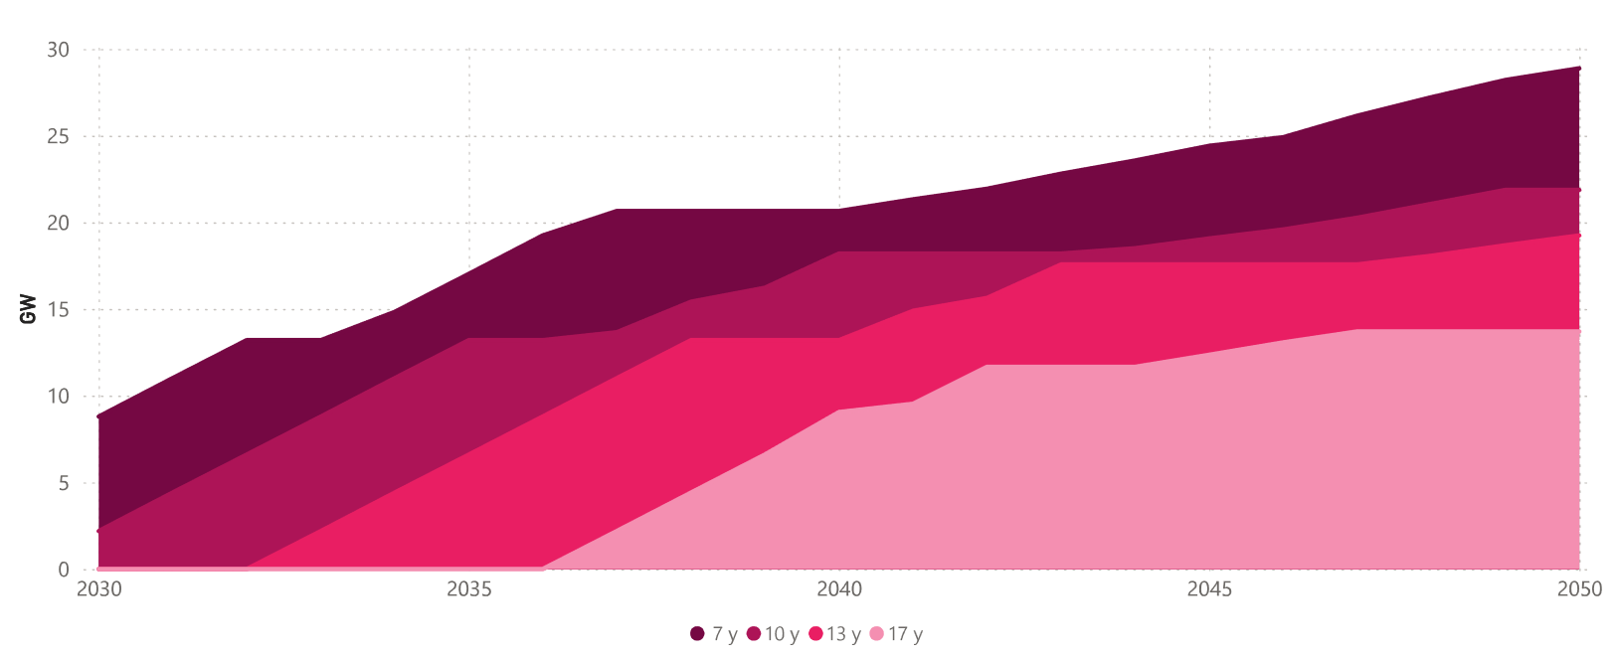
28.9
21.9
19.3
13.7

Slide 7
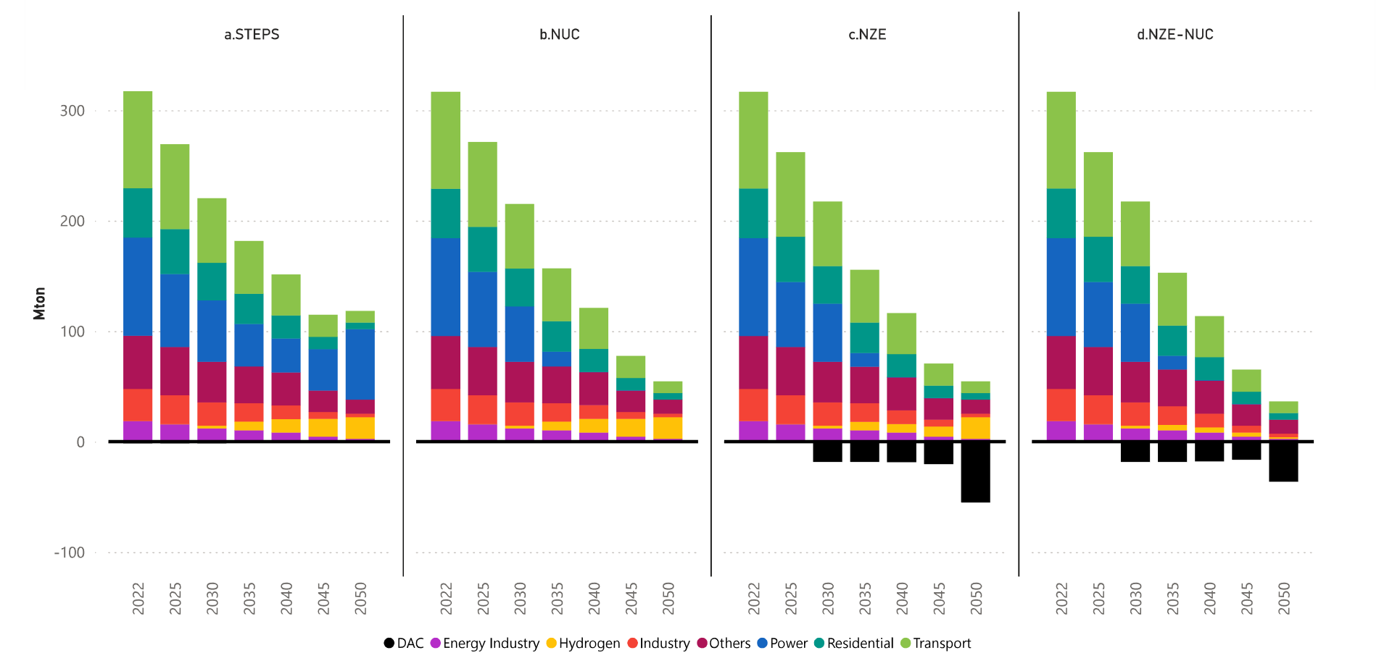

Slide 8
